Slide 1
Heaps

Slide 2
Agenda
To discuss about heaps and heap sort

Slide 3
Heaps
A heap is a complete binary tree, and the binary tree is a tree in which the node can have utmost two children.
A complete binary tree is a binary tree in which all the levels except the last level, i.e., leaf node should be completely filled, and all the nodes should be left-justified.

Slide 4
Types of heap
Min Heap
Max Heap

Slide 5
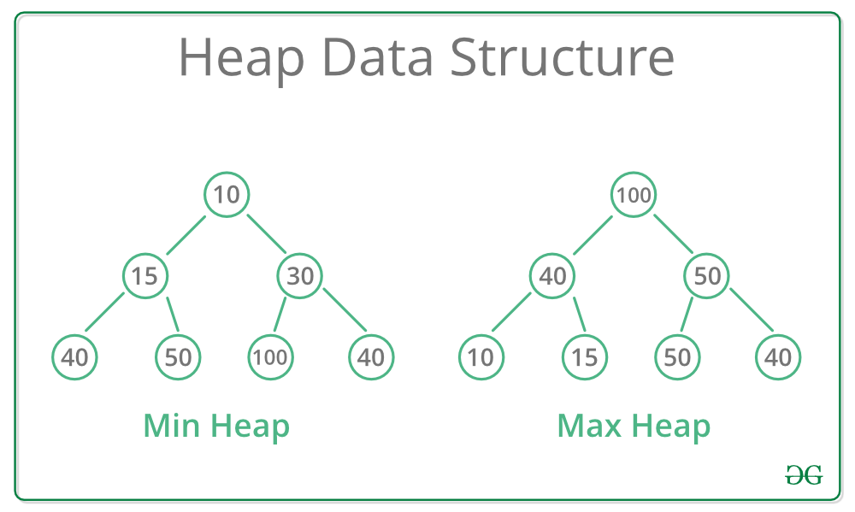
Min Heap & Max Heap
In a Min-Heap the key present at the root node must be minimum among the keys present at all of it’s children. The same property must be recursively true for all sub-trees in that Binary Tree.
In a Max-Heap the key present at the root node must be greatest among the keys present at all of it’s children. The same property must be recursively true for all sub-trees in that Binary Tree.

Slide 6
Applications of Heaps
Heap sort
Implementing Priority Queues
Selection algorithms : These algorithms are used to find the maximum and minimum values.
Graph algorithms : Used for implementing Prim’s MST and Dijkstra’s shortest path problem.

Slide 7
Inserting a New Element in a Max Heap
Consider a max heap H with n elements. Inserting a new value into the heap is done in the following
two steps:
1. Add the new value at the bottom of H in such a way that H is still a complete binary tree but
not necessarily a heap.
2. Let the new value rise to its appropriate place in H so that H now becomes a heap as well.

Slide 8
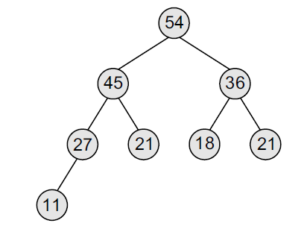
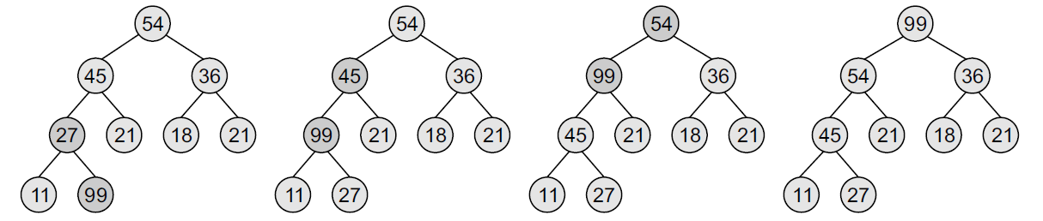

Insertion in Max heap
Inserting 99 in Max heap

Slide 9
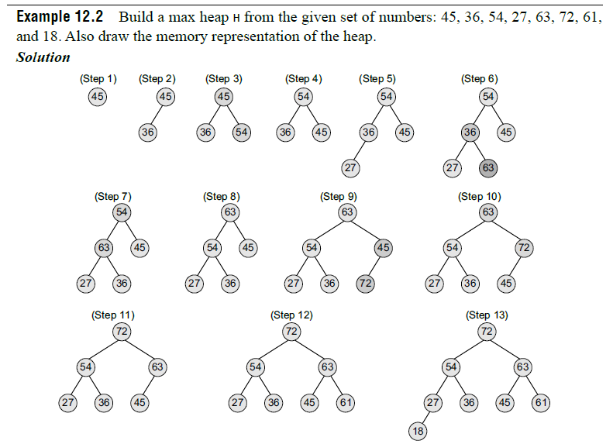
Building Max heap

Slide 10
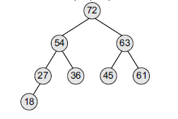
Memory representation

Slide 11
Deleting an element from Max heap
Consider a max heap H having n elements. An element is always deleted from the root of the heap. So, deleting an element from
the heap is done in the following three steps:
1. Replace the root node’s value with the last node’s value so that H is still a complete binary tree but not necessarily
a heap.
2. Delete the last node.
3. Sink down the new root node’s value so that H satisfies the heap property. In this step, interchange the root node’s value
with its child node’s value (whichever is largest among its children).

Slide 12
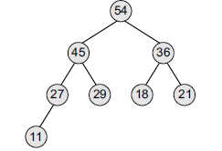
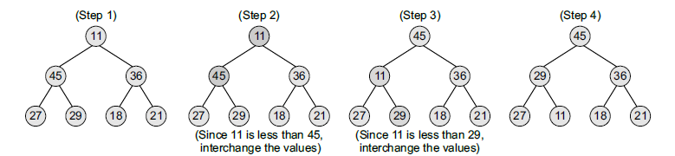
Delete the root node

Slide 13
How to “heapify” a tree?
The process of reshaping a binary tree into a Heap data structure is known as ‘heapify’. A binary tree is a tree data structure that has two child nodes at max. If a node’s children nodes are ‘heapified’, then only ‘heapify’ process can be applied over that node. A heap should always be a complete binary tree.
Starting from a complete binary tree, we can modify it to become a Max-Heap by running a function called ‘heapify’ on all the non-leaf elements of the heap. i.e. ‘heapify’ uses recursion.

Slide 14
Algorithm for “heapify”
heapify(array)
Root = array[0]
Largest = largest( array[0] , array [2 * 0 + 1], array[2 * 0 + 2])
if(Root != Largest)
Swap(Root, Largest)

Slide 15
Heapify implementation
// To heapify a subtree rooted with node i which is an index in arr[]. n is size of heap
void heapify(int arr[], int n, int i)
{
int largest = i; // Initialize largest as root
int l = 2 * i + 1; // left = 2*i + 1
int r = 2 * i + 2; // right = 2*i + 2
// If left child is larger than root
if (l < n && arr[l] > arr[largest])
largest = l;
// If right child is larger than largest so far
if (r < n && arr[r] > arr[largest])
largest = r;
// If largest is not root
if (largest != i) {
int swap = arr[i];
arr[i] = arr[largest];
arr[largest] = swap;
// Recursively heapify the affected sub-tree
heapify(arr, n, largest);
}
}

Slide 16
Heap sort
Heap Sort Algorithm for sorting in increasing order:
1. Build a max heap from the input data.
2. At this point, the largest item is stored at the root of the heap. Replace it with the last item of the heap followed by reducing the size of heap by 1. Finally, heapify the root of the tree.
3. Repeat step 2 while the size of the heap is greater than 1.

Slide 17
Heap sort example

Slide 18
Heap sort implementation
public void sort(int arr[])
{
int n = arr.length;
// Build heap (rearrange array)
for (int i = n / 2 - 1; i >= 0; i--)
heapify(arr, n, i);
// One by one extract an element from heap
for (int i = n - 1; i > 0; i--) {
// Move current root to end
int temp = arr[0];
arr[0] = arr[i];
arr[i] = temp;
// call max heapify on the reduced heap
heapify(arr, i, 0);
}
}

Slide 19
Time Complexity
Time complexity of heapify is O(Logn). Time complexity of createAndBuildHeap() is O(n) and the overall time complexity of Heap Sort is O(nLogn).

Slide 20
Advantages of heapsort
Efficiency – The time required to perform Heap sort increases logarithmically while other algorithms may grow exponentially slower as the number of items to sort increases. This sorting algorithm is very efficient.
Memory Usage – Memory usage is minimal because apart from what is necessary to hold the initial list of items to be sorted, it needs no additional memory space to work.
Simplicity – It is simpler to understand than other equally efficient sorting algorithms because it does not use advanced computer science concepts such as recursion.

Slide 21
Summary
You have learnt basics of heaps and heap sort.

Slide 22
Thank You

